Slide 1

Fake Job Posting Detection Using Supervised Machine Learning
Team Members:
Vishesh Bharuka
Sujan DM

Slide 2
Introduction
Online Job platforms are increasingly being targeted by fraudsters.
Fake job postings can exploit users for financial and personal gain.
The fake job postings can also result in financial scams , identity theft and personal data leaks.
Our Goal was to build an ML pipeline to detect and flag suspicious listings.

Slide 3
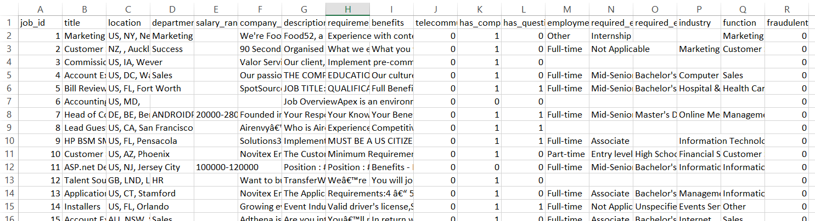
Dataset overview
Source: Kaggle – “Fake Job Postings” dataset
Records: ~18,000 job listings with various attributes
Target Label: fraudulent (0 = real, 1 = fake)
Key Features : Title, Description, requirements, company_profile and more
Source : Fake Job Postings

Slide 4
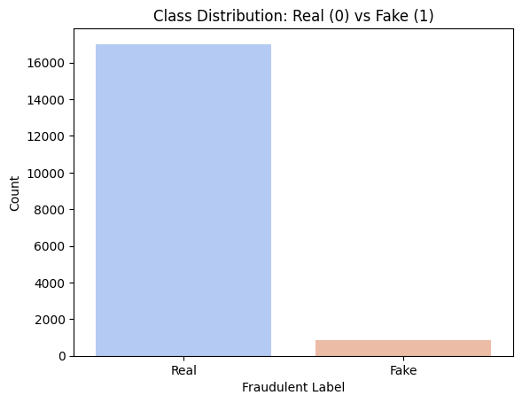
PRE-PROCESSING STEPS
Missing values: Handled missing values by filling with a default one.
Feature Encoding: Applied TF-IDF encoding to few columns.
Handling Imbalance: Since Fake job postings are fewer than real ones, applied SMOTE to balance dataset
Dropped low impact categorical fields for simplicity.

Slide 5
WORKFLOW
Feature Engineering: TF-IDF vectorization was applied individually to description, requirements and company profile.
Model Training: 4 models were compared – Logistic Regression, Decision Tree, Random Forest and XGBoost. Random Forest showed the best example and was selected.
The trained Random forest model and the three vectorizers were saved as .pkl files
APP built using Streamlit

Slide 6
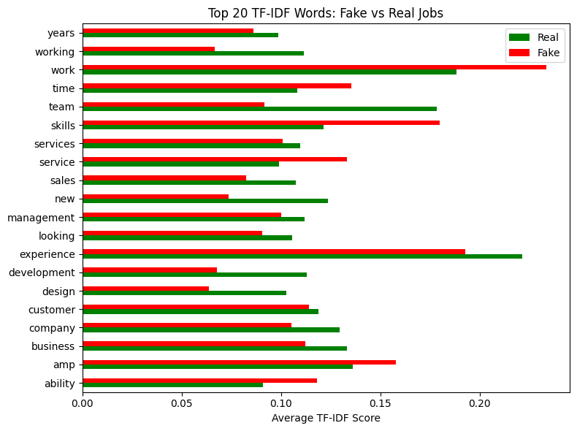
TOP 20 TF-IDF WORDS : Fake vs Real

Slide 7
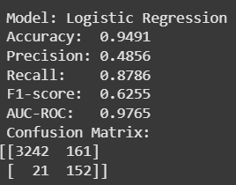
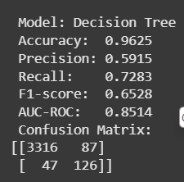
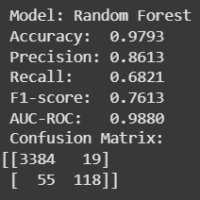
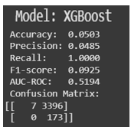
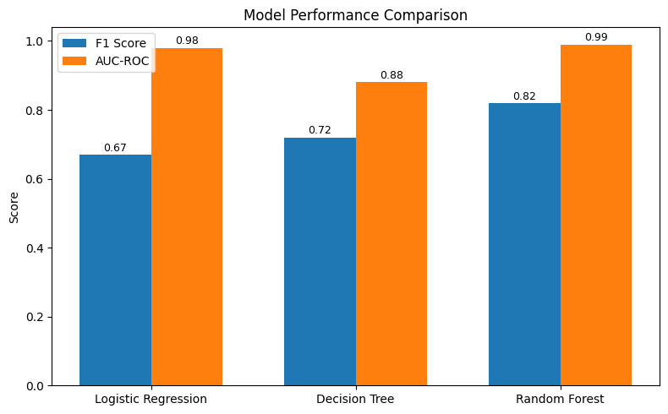
Confusion Matrix and Scores

Slide 8
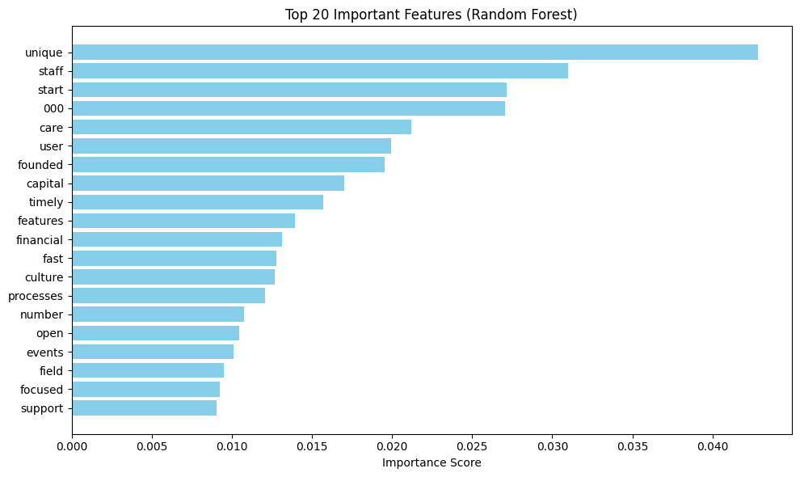
TOP 20 IMPORTANT FEATURES (RANDOM FOREST)

Slide 9
Streamlit App Integration
Built a web app with Streamlit app simulate real-world use
User inputs job title, description, requirements and company profile.
Displays result as Real or Fake with confidence scores
Deployed Temporarily via Ngrok in Colab

Slide 10
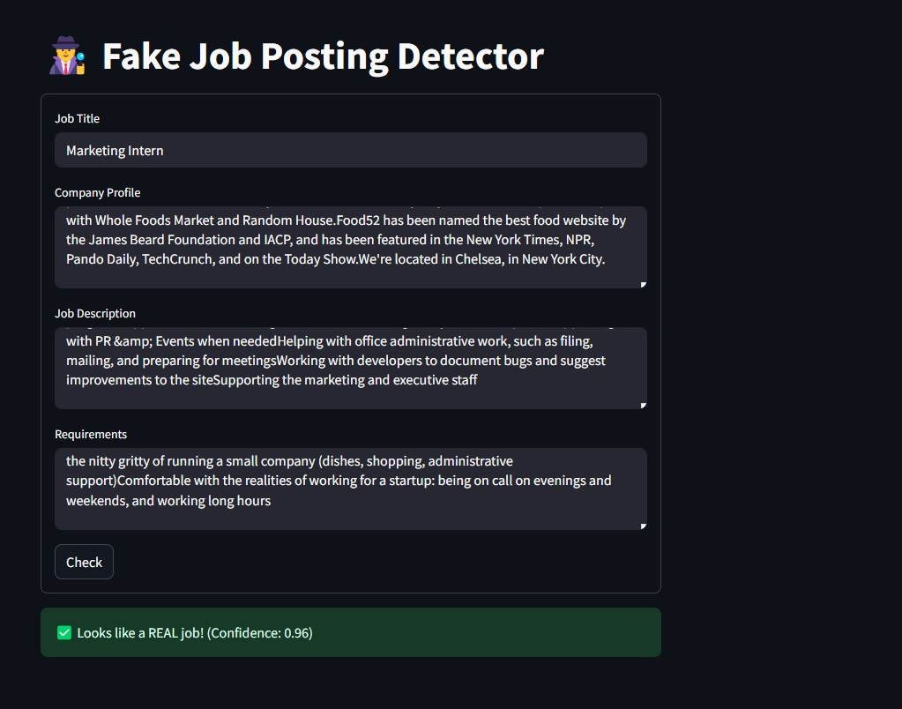
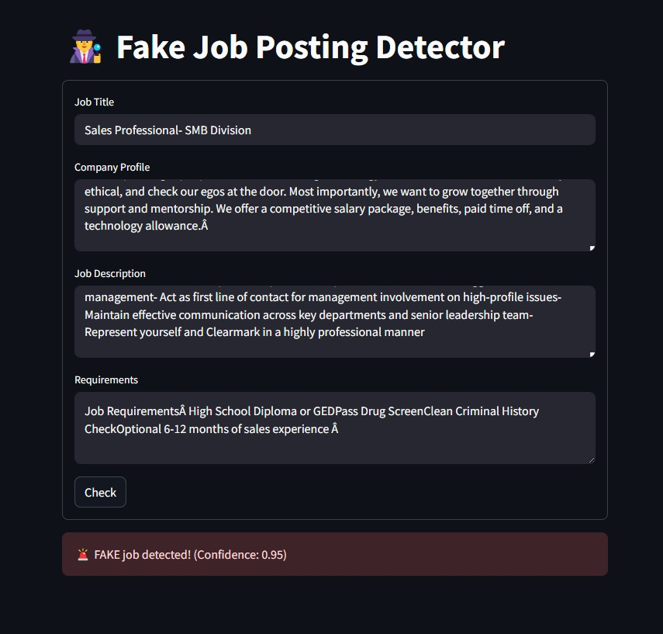
Streamlit App Integration

Slide 11
CONCLUSION
Developed a scalable pipeline capable of detecting fake job listings with high confidence.
Successfully addressed data imbalance using SMOTE and selected optimal features using TF-IDF
Demonstrated deployment through a functional and interactive web app using Streamlit

Slide 12
FUTURE SCOPE
Experiment with advanced NLP models like BERT, or LLM-based embeddings for deeper semantic understanding.
Scale deployment using platforms like Streamlit Cloud, Hugging Face Spaces
Integrate with job boards via APIs
Extend to multilingual support and real-time moderation dashboards for global application.

